Slide 1
Data Link Control
Dr Sujit Das

Slide 2
DLC SERVICES
The data link control (DLC) deals with procedures for communication between two adjacent nodes—node-to-node communication—no matter whether the link is dedicated or broadcast.
Data link control functions include framing and flow and error control.
In this section, we first discuss framing, or how to organize the bits that are carried by the physical layer. We then discuss flow and error control.

Slide 3
Framing
Data transmission in the physical layer means moving bits in the form of a signal from the source to the destination.
The physical layer provides bit synchronization to ensure that the sender and receiver use the same bit durations and timing.
The data-link layer, on the other hand, needs to pack bits into frames, so that each frame is distinguishable from another.
Our postal system practices a type of framing. The simple act of inserting a letter into an envelope separates one piece of information from another;
the envelope serves as the delimiter. In addition, each envelope defines the sender and receiver addresses, which is necessary since the postal system is a many-to-many carrier facility.

Slide 4
Frames
Framing in the data-link layer separates a message from one source to a destination by adding a sender address and a destination address.
The destination address defines where the packet is to go; the sender address helps the recipient acknowledge the receipt.
Although the whole message could be packed in one frame, that is not normally done. One reason is that a frame can be very large, making flow and error control very inefficient.
When a message is carried in one very large frame, even a single-bit error would require the retransmission of the whole frame.
When a message is divided into smaller frames, a single-bit error affects only that small frame.

Slide 5
Frame Size
Frames can be of fixed or variable size.
In fixed-size framing, there is no need for defining the boundaries of the frames; the size itself can be used as a delimiter.
An example of this type of framing is the ATM WAN, which uses frames of fixed size called cells.
Our main discussion in this chapter concerns variable-size framing, prevalent in local-area networks.
In variable-size framing, we need a way to define the end of one frame and the beginning of the next.
Historically, two approaches were used for this purpose: a character-oriented approach and a bit-oriented approach.

Slide 6
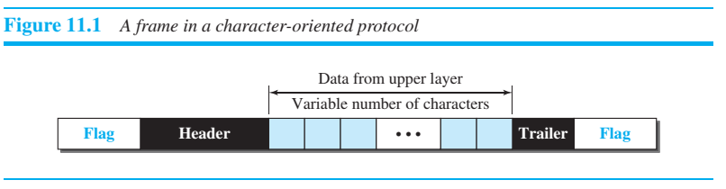
Character-Oriented Framing
In character-oriented (or byte-oriented) framing, data to be carried are 8-bit characters from a coding system such as ASCII
The header, which normally carries the source and destination addresses and other control information, and the trailer, which carries error detection redundant bits, are also multiples of 8 bits.
To separate one frame from the next, an 8-bit (1-byte) flag is added at the beginning and the end of a frame. The flag, composed of protocol-dependent special characters, signals the start or end of a frame.
Figure 11.1 shows the format of a frame in a character-oriented protocol.

Slide 7
Character-oriented framing
Character-oriented framing was popular when only text was exchanged by the data-link layers.
The flag could be selected to be any character not used for text communication. Now, however, we send other types of information such as graphs, audio, and video;
Any character used for the flag could also be part of the information.
If this happens, the receiver, when it encounters this pattern in the middle of the data, thinks it has reached the end of the frame.
To fix this problem, a byte-stuffing strategy was added to character-oriented framing.
In byte stuffing (or character stuffing), a special byte is added to the data section of the frame when there is a character with the same pattern as the flag.
The data section is stuffed with an extra byte. This byte is usually called the escape character (ESC) and has a predefined bit pattern.
Whenever the receiver encounters the ESC character, it removes it from the data section and treats the next character as data, not as a delimiting flag. Figure 11.2 shows the situation.

Slide 8
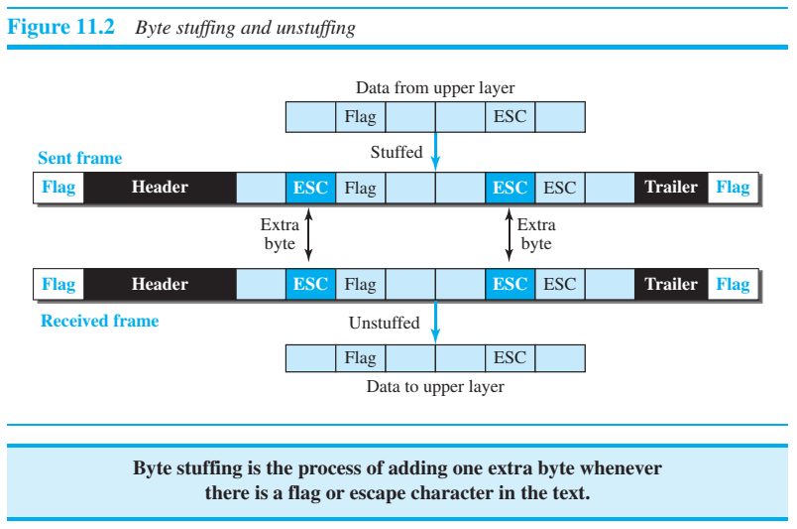
Byte stuffing and unstuffing

Slide 9
Byte stuffing
Byte stuffing by the escape character allows the presence of the flag in the data section of the frame, but it creates another problem.
What happens if the text contains one or more escape characters followed by a byte with the same pattern as the flag?
The receiver removes the escape character, but keeps the next byte, which is incorrectly interpreted as the end of the frame.
To solve this problem, the escape characters that are part of the text must also be marked by another escape character.
In other words, if the escape character is part of the text, an extra one is added to show that the second one is part of the text.
Character-oriented protocols present another problem in data communications.
The universal coding systems in use today, such as Unicode, have 16-bit and 32-bit characters that conflict with 8-bit characters.
We can say that, in general, the tendency is moving toward the bit-oriented protocols that we discuss next.

Slide 10
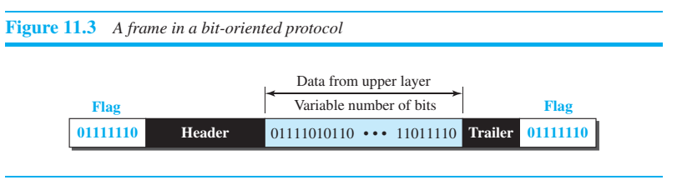
Bit-Oriented Framing
In bit-oriented framing, the data section of a frame is a sequence of bits to be interpreted by the upper layer as text, graphic, audio, video, and so on.
However, in addition to headers (and possible trailers), we still need a delimiter to separate one frame from the other.
Most protocols use a special 8-bit pattern flag, 01111110, as the delimiter to define the beginning and the end of the frame, as shown in Figure 11.3.

Slide 11

Bit-Oriented Framing
This flag can create the same type of problem we saw in the character-oriented protocols. That is, if the flag pattern appears in the data, we need to somehow inform the receiver that this is not the end of the frame.
We do this by stuffing 1 single bit (instead of 1 byte) to prevent the pattern from looking like a flag. The strategy is called bit stuffing.
In bit stuffing, if a 0 and five consecutive 1 bits are encountered, an extra 0 is added. This extra stuffed bit is eventually removed from the data by the receiver.
Note that the extra bit is added after one 0 followed by five 1s regardless of the value of the next bit. This guarantees that the flag field sequence does not inadvertently appear in the frame.

Slide 12
Bit stuffing
Figure 11.4 shows bit stuffing at the sender and bit removal at the receiver.
Note that even if we have a 0 after five 1s, we still stuff a 0. The 0 will be removed by the receiver.
This means that if the flag like pattern 01111110 appears in the data, it will change to 011111010 (stuffed) and is not mistaken for a flag by the receiver.
The real flag 01111110 is not stuffed by the sender and is recognized by the receiver.

Slide 13
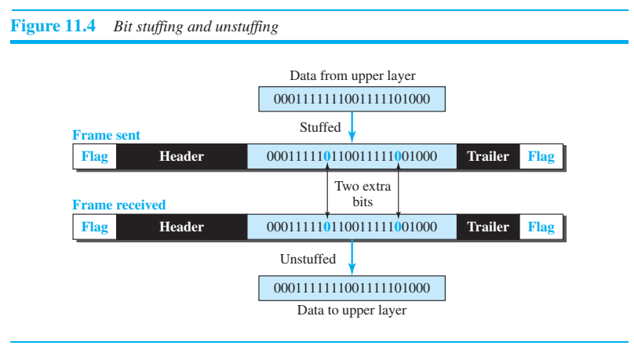
Bit stuffing and unstuffing

